Slide 1

國立臺北科技大學 電子工程研究所 碩 士 班 畢 業 論 文 口 試
基於蟻群最佳化之有效稀疏近似法
應用於除去高密度脈衝雜訊
An Efficient Sparse Approximation using Ant Colony Optimization for High Density Impulse Noise Removal
報告者：張家豪
指導教授：黃士嘉 教授
日期：2016.7.7
Notes:
郭、顏、蔡、黃

Slide 2
Outline
Introduction
Background
Proposed method
Sparse Representation module
Ant-colony Optimization module
Experimental results
Conclusions
References

Slide 3
Introduction(1/2)
Median filter is the traditional way for impulse noise removal [2]-[6].
But these approaches cannot contend with images featuring high-density impulse noise (the percentage of noise is over 50% within an image).
Fig. 1. Illustration of median filter
Notes:
針對impulse noise的去除，傳統的方法為使用Mean or Median.
但對於高密度的impulse noise 這些方法可能就不適用

Slide 4
Introduction(2/2)
Recent investigations have employed the sparse approximation strategy to represent the visually pleasing noise-free image in comparison with the use of median filter for high density impulse noise[7]-[10].
Notes:
對於高密度的impulse noise的去除，近年來有人便提出了sparse approximation的方式來與傳統的median做比較
但是這樣的方法在當雜訊的百分比大於70%時，常常會失敗

Slide 5
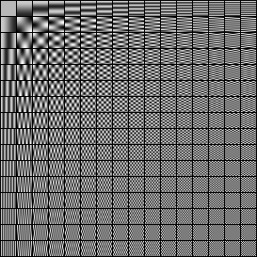
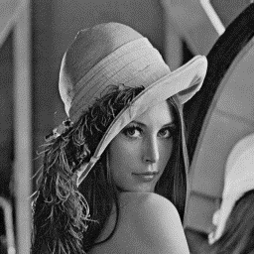
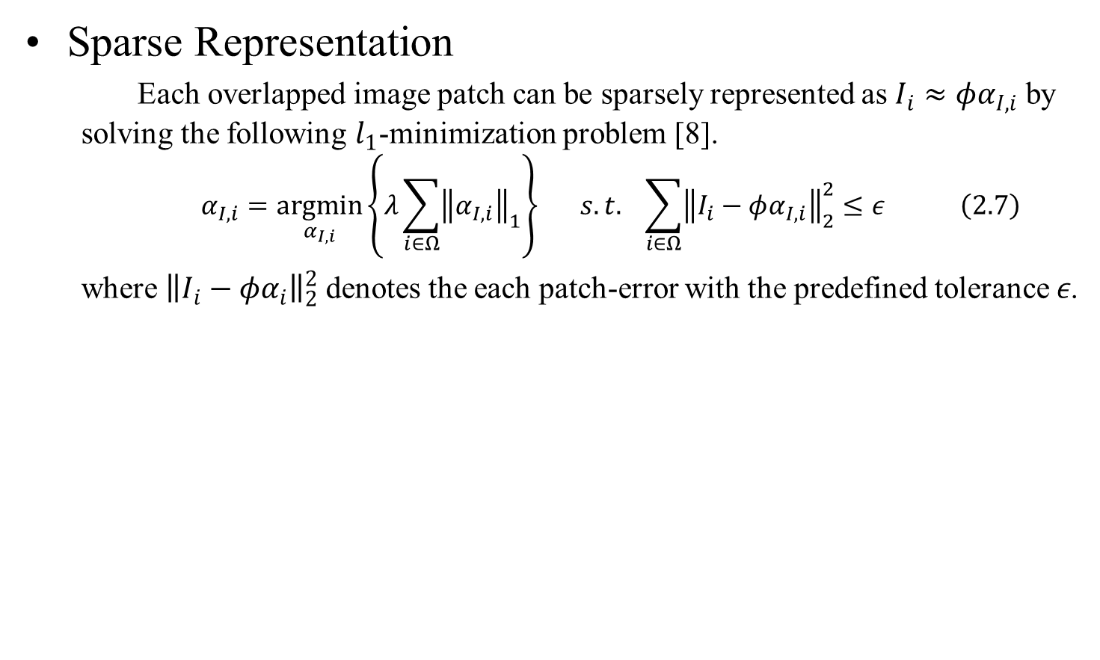
Background(1/3)
Sparse Representation
Each overlapped image patch can be sparsely represented as $I_{i}≈φα_{I,i}$ by solving the following $l_{1}$-minimization problem [8].
$$α_{I,i}=\underset{α_{I,i}}{argmin}\left\{λ\sum_{i∈Ω}{{\left\|α_{I,i}\right\|}_{1}}\right\} s.t. \sum_{i∈Ω}{{\left\|I_{i}−φα_{I,i}\right\|}_{2}^{2}}≤ε \left(2.7\right)$$
where ${\left\|I_{i}−φα_{i}\right\|}_{2}^{2}$ denotes the each patch-error with the predefined tolerance $ε$.
0.7
0.2
0.1
Fig. 2. Illustration of Sparse Representation using DCT based dictionary.
Notes:
首先我們先介紹甚麼是sparse representation，SR的精神就是希望能透過一個字典，並將內部的資訊透過一定的權重來重組影像。($I_{i}≈φα_{I,i}$)
用圖解釋

Slide 6
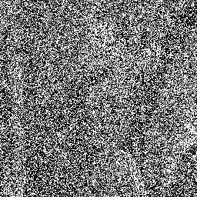
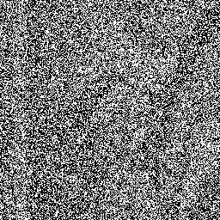
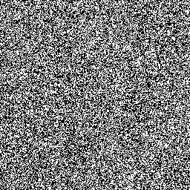
Background(2/3)
But these techniques usually fail to recover the corrupted image when the percentage of noise within an image is over 70%.
Origin(Lena)
70% Noise Image
80% Noise Image
90% Noise Image
Fig. 3. Comparison of "Lena" image corrupted with different percentages of impulse noises ranging from 70% to 90%.

Slide 7
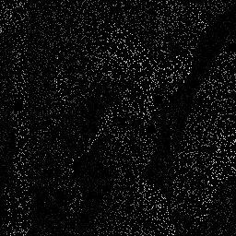
Background(3/3)
This is because, under such conditions, noise-free pixels are not sufficiently present within each cropped window to facilitate learning sparse approximation for these learning based techniques.
Origin(Lena)
90% Noise Image
Noise-free pixels
Fig. 4. Illustration of noise-free pixels of image “Lena” which corrupted with 90% impulse noise.
Notes:
而這是因為在高密度雜訊的狀況下，sparse approximation所擷取出來的patch，無法提供足夠的影像資訊來作learning

Slide 8
Proposed method(1/11)
In response, we propose our method which is composed of two important modules: a Sparse Representation (SR) module and an Ant-colony Optimization (AO) module.
Fig. 5. Overview of the proposed noise removal method.
Notes:
所以為了解決這樣的高密度雜訊，我們便提出我們的方法，主要包含兩個模組 SR and AO

Slide 9
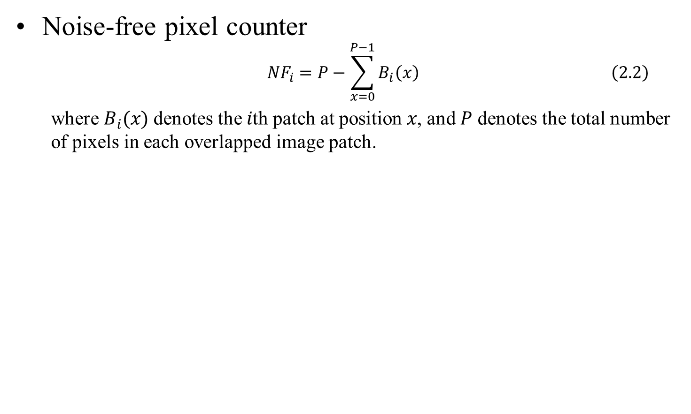
SR module(2/11)
Noise-free pixel counter
$${NF}_{i}=P−\sum_{x=0}^{P−1}{B_{i}\left(x\right) \left(2.2\right)}$$
where $B_{i}(x)$ denotes the $i$th patch at position $x$, and $P$ denotes the total number of pixels in each overlapped image patch.
Fig. 6. Illustration of noise-free pixel counter ${NF}_{i}$ in the overlapped image patches.
Notes:
透過剛剛的Noise Detector後，便會產生如圖的資訊
SR 會overlap 取 patch ， 所以每個取出的patch就會如圖
而NFPC其實就是將每一個overlapped的patch內NF的點作一個加總

Slide 10
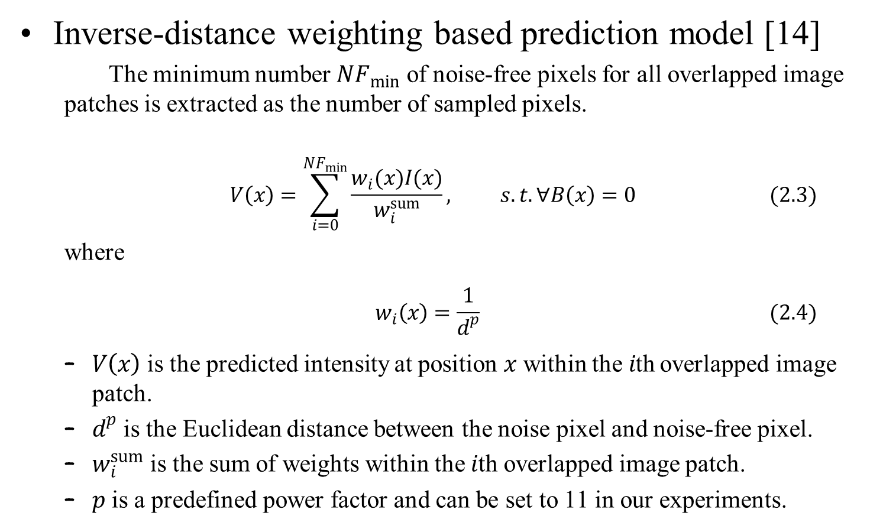
SR module(3/11)
Inverse-distance weighting based prediction model [14]
The minimum number ${NF}_{min}$ of noise-free pixels for all overlapped image patches is extracted as the number of sampled pixels.
$$V\left(x\right)=\sum_{i=0}^{{NF}_{min}}{\frac{w_{i}(x)I(x)}{w_{i}^{sum}}}, s.t. ∀B\left(x\right)=0 (2.3)$$
where
$$w_{i}\left(x\right)=\frac{1}{d^{p}} (2.4)$$
$V\left(x\right)$ is the predicted intensity at position $x$ within the$i$th overlapped image patch.
$d^{p}$ is the Euclidean distance between the noise pixel and noise-free pixel.
$w_{i}^{sum}$ is the sum of weights within the $i$th overlapped image patch.
$p$ is a predefined power factor and can be set to 11 in our experiments.
Notes:
為什麼剛剛要計算NF，是因為在IDW時，我們會把NF_min拿來當sample的數量。
ID 顧名思義就是與距離成反比的權重，所以可以看到2.4 會計算NP跟NFP的距離，並組成新的權重值來預測該點的影像值

Slide 11
SR module(4/11)
Fig. 7. Illustration of distance between the noise pixel marked by * and noise-free pixel marked by red circles in the IDW prediction model.
Notes:
依圖解釋IDW

Slide 12
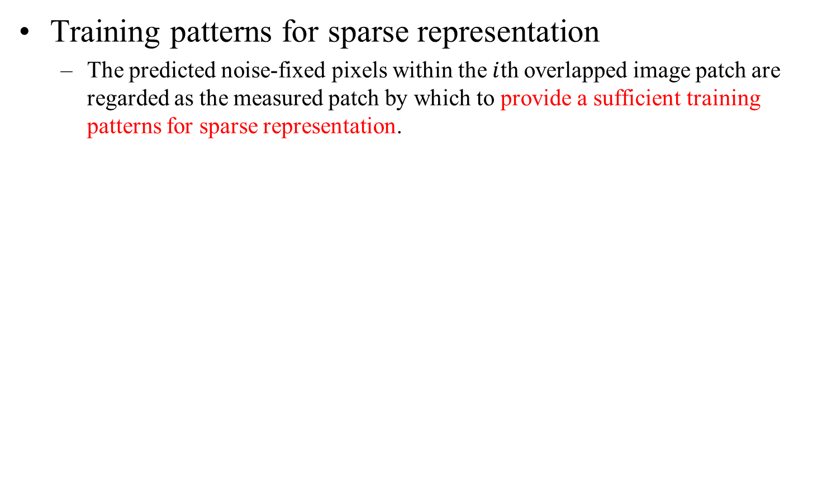
SR module(5/11)
Training patterns for sparse representation
The predicted noise-fixed pixels within the$i$th overlapped image patch are regarded as the measured patch by which to provide a sufficient training patterns for sparse representation.
Fig. 8. Illustration of the training patterns after using the IDW prediction model.
Notes:
經過剛剛的IDW prediction後 便可以得到一個足夠影像資訊的training pattern 來供SR作學習

Slide 13
AO module(6/11)
According to the IDW based prediction model, different sampled noise-free pixels might have different prediction effects to the noise-fixed pixels.
So, we propose the AO module in order to seek a better result, and the principles of AO module include these three steps:
Constructing ant solutions
Reinforcing and evaporating pheromones
Searching locally for improved solutions
Notes:
因為取樣的排列組合會很多，所以我們希望透過AO來處理這樣的排列組合問題，藉此來找尋更好的影像結果
我們所提出的AO module 包含以下三個步驟

Slide 14
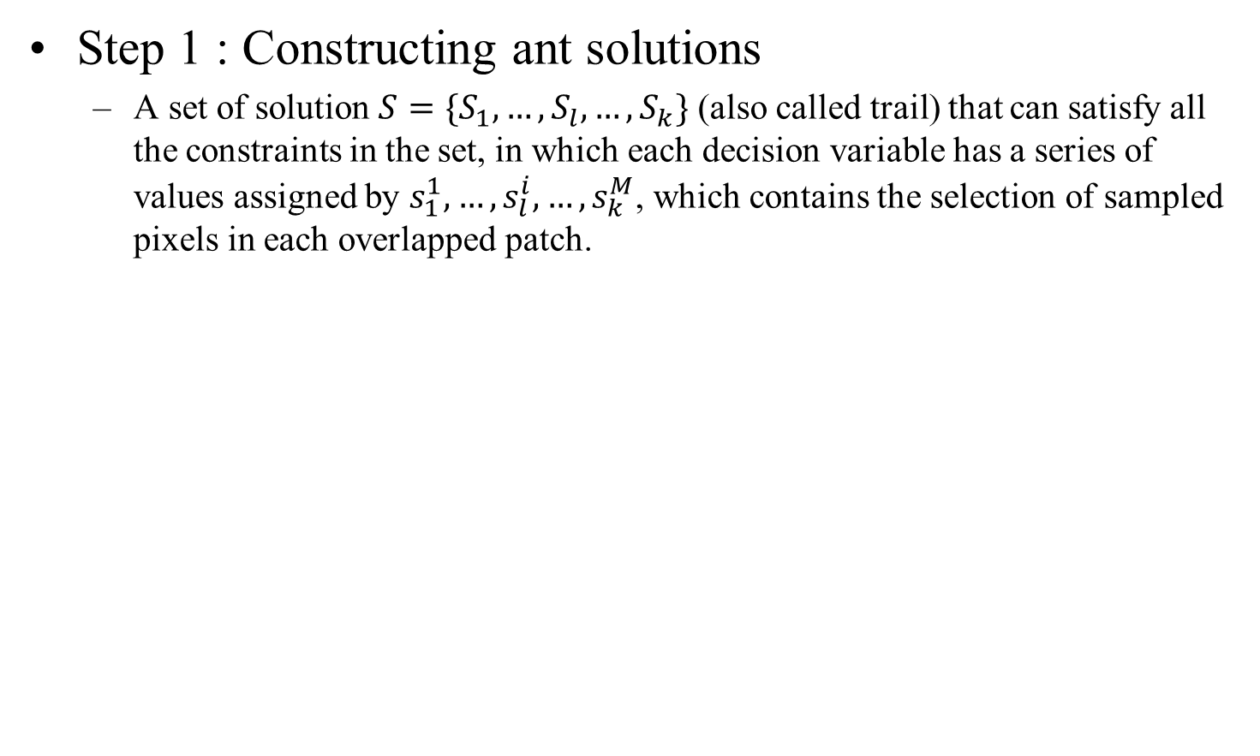
AO module(7/11)
Step 1 : Constructing ant solutions
A set of solution $S=\{S_{1},…,S_{l},…,S_{k}\}$ (also called trail) that can satisfy all the constraints in the set, in which each decision variable has a series of values assigned by $s_{1}^{1},…,s_{l}^{i},…,s_{k}^{M}$, which contains the selection of sampled pixels in each overlapped patch.
Fig. 9. Illustration of solution set kept by the proposed AO module.
Notes:
做解，一開始我們是隨機產生解，
依圖解釋trail (S) , local selection (s)

Slide 15
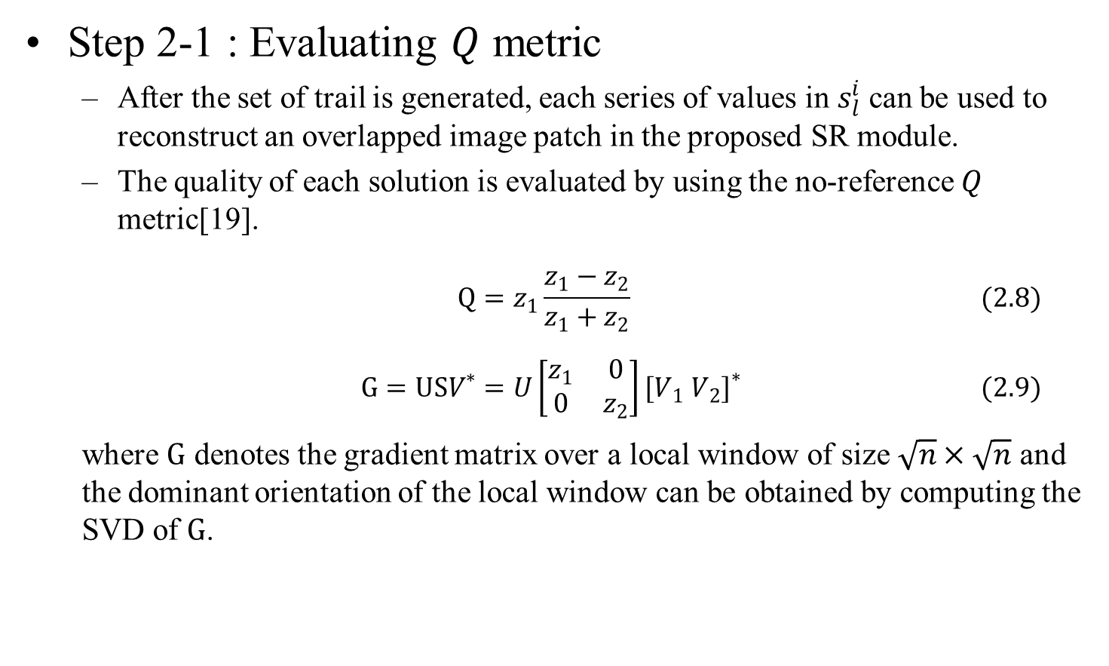
AO module(8/11)
Step 2-1 : Evaluating $Q$ metric
After the set of trail is generated, each series of values in $s_{l}^{i}$ can be used to reconstruct an overlapped image patch in the proposed SR module.
The quality of each solution is evaluated by using the no-reference $Q$ metric[19].
$$Q=z_{1}\frac{z_{1}−z_{2}}{z_{1}+z_{2}} (2.8)$$
$$G=USV^{∗}=U\left[\begin{matrix}z_{1} & 0 \\ 0 & z_{2}\end{matrix}\right]{[V_{1} V_{2}]}^{∗} (2.9)$$
where $G$ denotes the gradient matrix over a local window of size $\sqrt{n}×\sqrt{n}$ and the dominant orientation of the local window can be obtained by computing the SVD of $G$.
Notes:
將剛剛產生出來的解送入SR module去修復影像
得到修復影像後，透過no-reference 的 Q metric來評估影像的品質
解釋Q metric

Slide 16
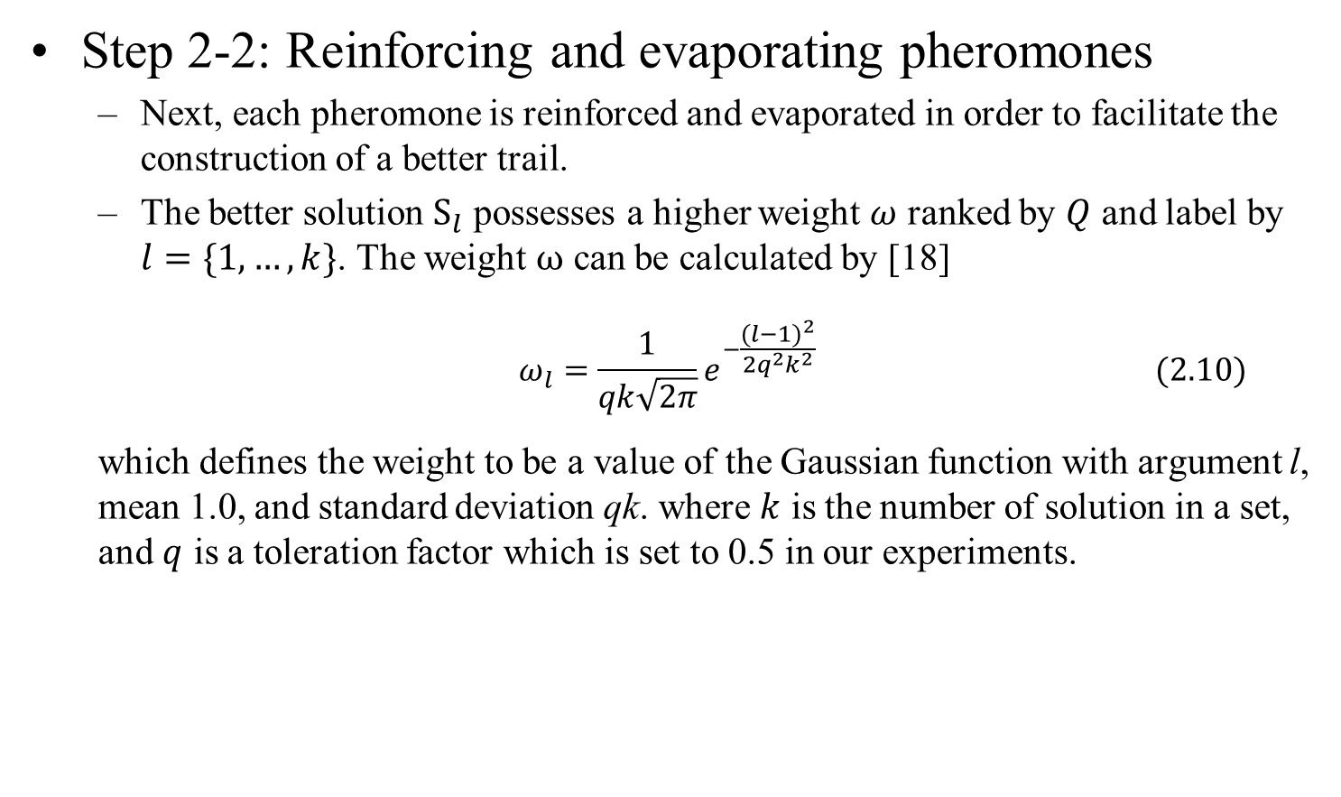
AO module(9/11)
Step 2-2: Reinforcing and evaporating pheromones
Next, each pheromone is reinforced and evaporated in order to facilitate the construction of a better trail.
The better solution $S_{l}$ possesses a higher weight $ω$ ranked by $Q$ and label by $l=\{1,…,k\}$. The weight $ω$ can be calculated by [18]
$$ω_{l}=\frac{1}{qk\sqrt{2π}}e^{−\frac{{(l−1)}^{2}}{2q^{2}k^{2}}} (2.10)$$
which defines the weight to be a value of the Gaussian function with argument l, mean 1.0, and standard deviation qk. where $k$ is the number of solution in a set, and $q$ is a toleration factor which is set to 0.5 in our experiments.
Notes:
由於我們希望Q值越高的trail 能有越高的權重，所以會先將解依照Q來重新排序，並使用了如下公式的方式，來算出其代表的權重值

Slide 17
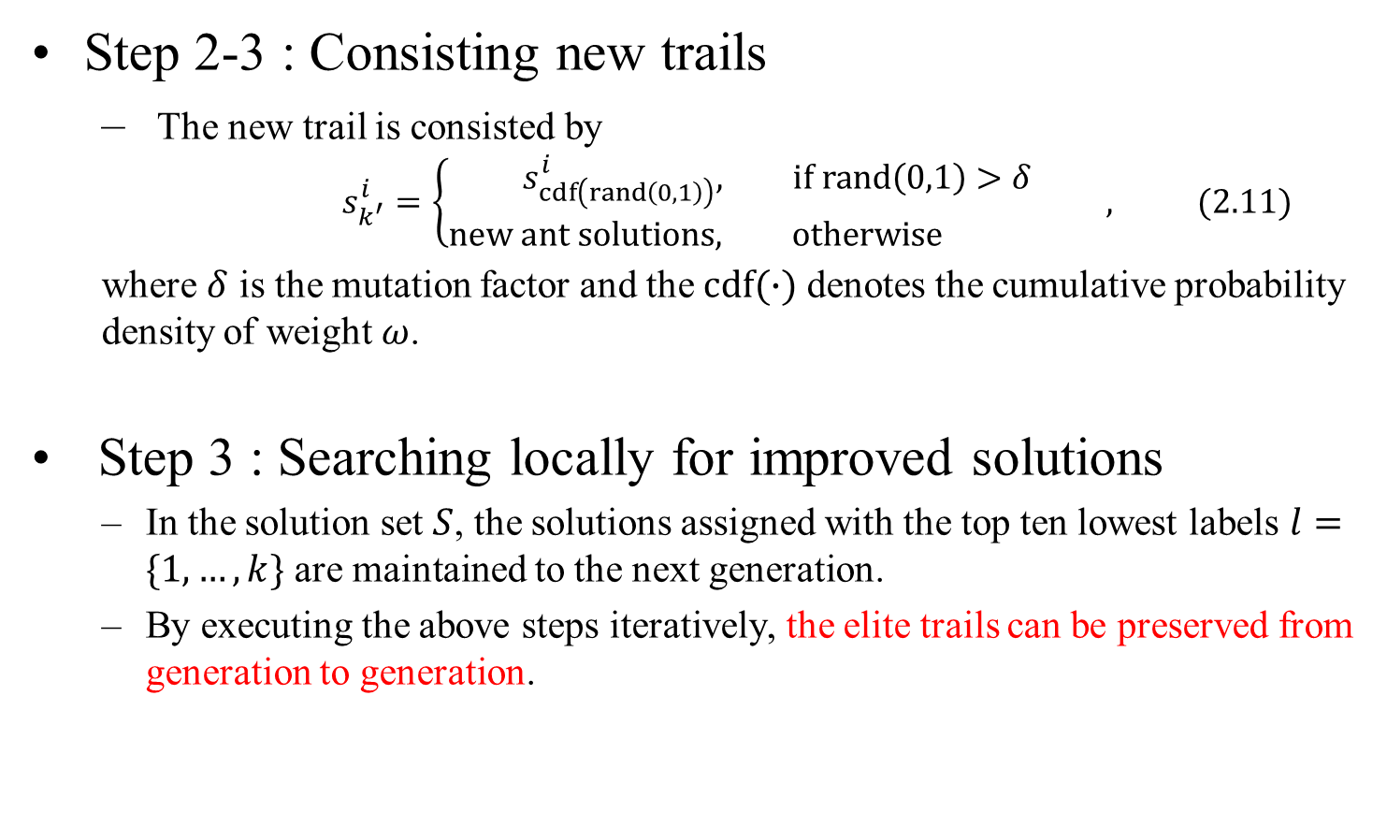
AO module(10/11)
Step 2-3 : Consisting new trails
The new trail is consisted by
$$s_{k^{′}}^{i}=\left\{\begin{aligned}s_{cdf\left(rand\left(0,1\right)\right)}^{i}, if rand\left(0,1\right)>δ \\ new ant solutions, otherwise \end{aligned},\right. (2.11)$$
where $δ$ is the mutation factor and the $cdf(∙)$ denotes the cumulative probability density of weight $ω$.
Step 3 : Searching locally for improved solutions
In the solution set $S$, the solutions assigned with the top ten lowest labels $l=\{1,…,k\}$ are maintained to the next generation.
By executing the above steps iteratively, the elite trails can be preserved from generation to generation.
Notes:
在來就是會產生新的解，由於一個patch的sample取法可能會大於我們所保留的解數，所以為了希望各種取法都有可能被納入我們的解集合中，
所以我們使用的一個突變的機制，來讓原本不在解集合內的取法有機會進入解集合。
而新的解會依據如下的方式構成
再來我們會對於每個世代保留k個解，並透過這樣的方式重複處理，如此以來便可以使最好的解一個世代一個世代的傳下去

Slide 18
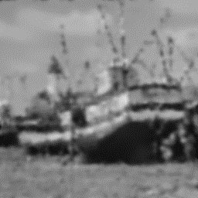
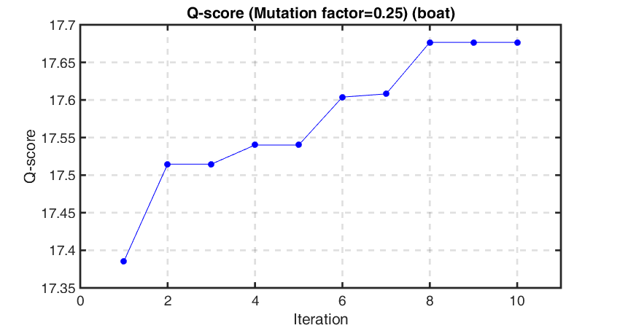
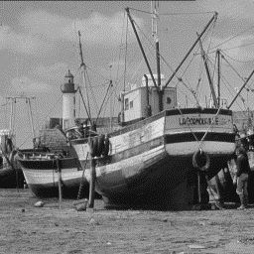

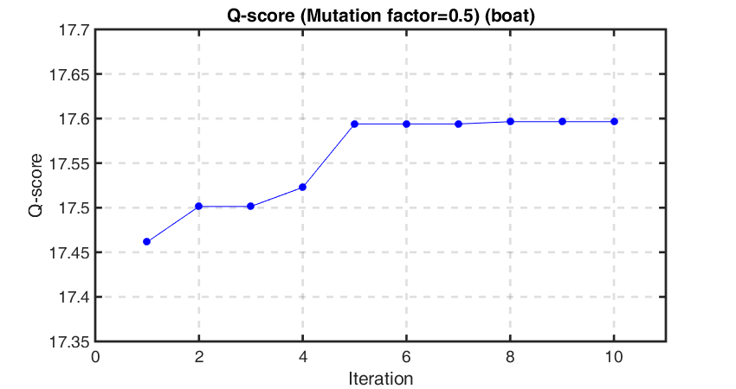
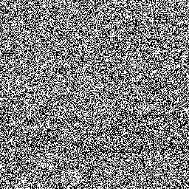
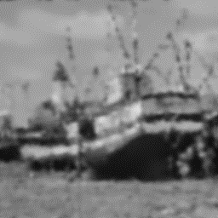
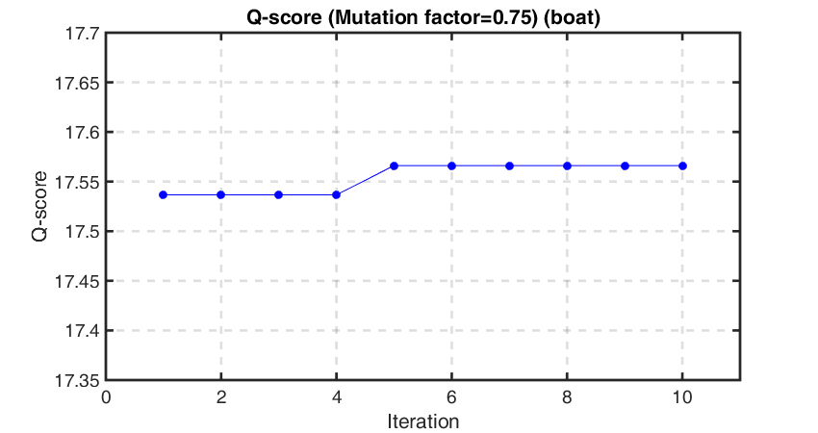
AO module(11/11)
Origin(Boat)
PSNR: 22.5803
90% Noise image
PSNR: 22.5635
PSNR: 5.8569
PSNR: 22.5505
Fig. 10. Comparison between the reconstructed images via different values
of the mutation factor in the proposed AO module.
Notes:
突變率的測試

Slide 19
Experimental results(1/6)
Origin(Car2)
Fig. 11. Illustration of the ”Car2” image reconstructed by using each compared method as the impulse noises increased from 70% to 90%.

Slide 20
Experimental results(2/6)
Origin(Venice)
Fig. 12. Illustration of the ”Venice” image reconstructed by using each compared method as the impulse noises increased from 70% to 90%.

Slide 21
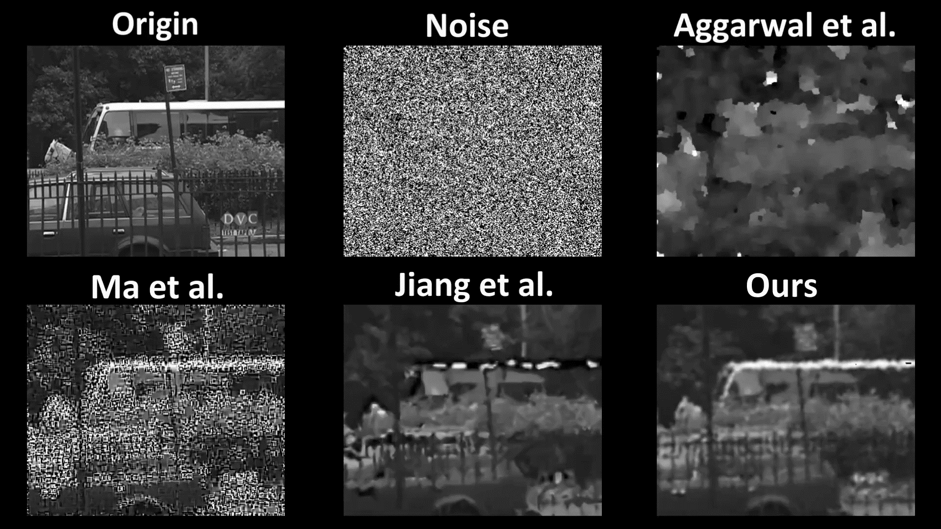
Experimental results(3/6)
PSNR Scores are as follow. Noise : 5.3696; Aggarwal et al. : 15.3374;
Ma et al. : 9.8692; Jiang et al. : 15.8030; Ours : 19.3477.
Notes:
Video 2

Slide 22
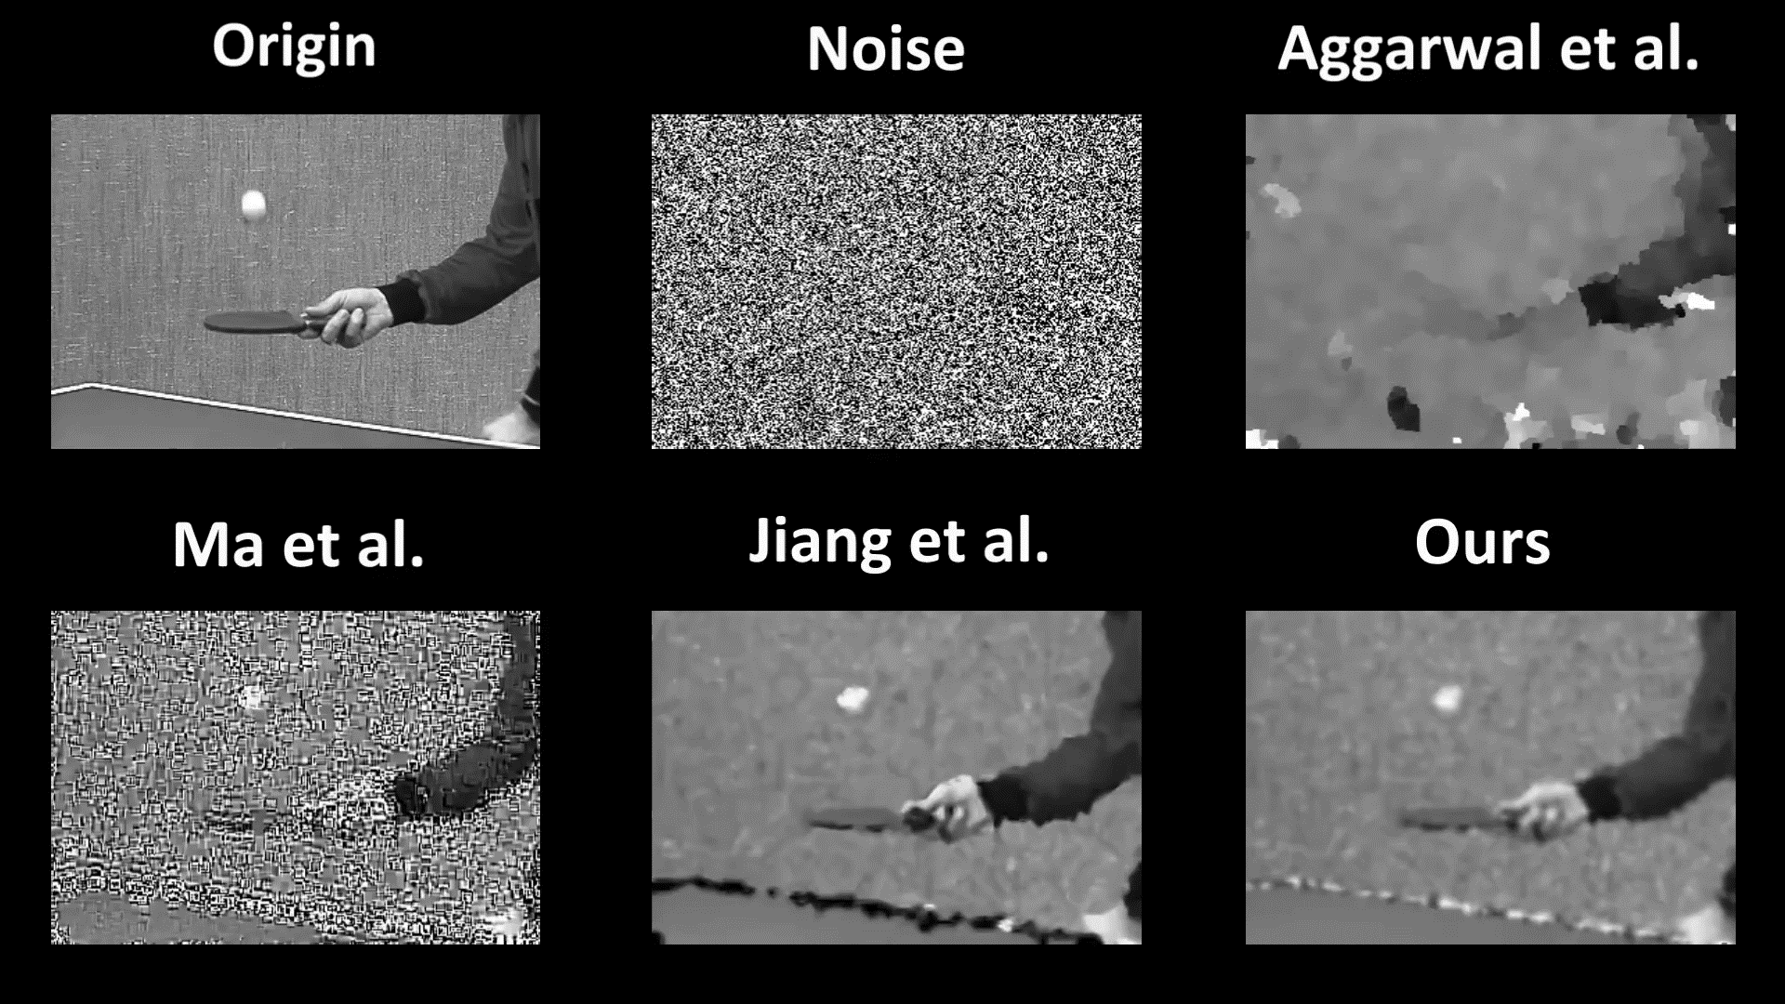
Experimental results(4/6)
PSNR Scores are as follow. Noise : 5.9755; Aggarwal et al. : 16.9973;
Ma et al. : 10.7040; Jiang et al. : 15.6302; Ours : 19.6413.
Notes:
Video 1

Slide 23
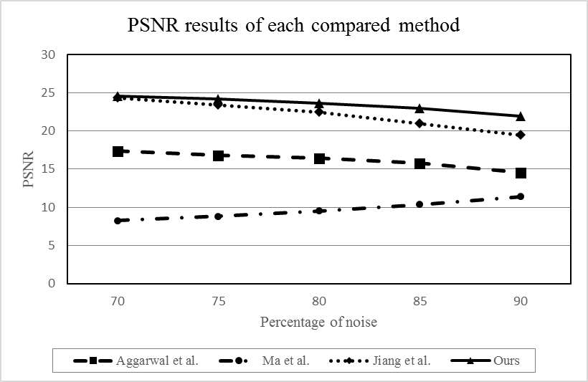
Experimental results(5/6)
PSNR Score over 15 gray scale image sets
Fig. 13. Comparison of PSNR results between each compared method for fifteen high density noise images, where the percentage of noise is increased from 70% to 90%
Notes:
PSNR

Slide 24
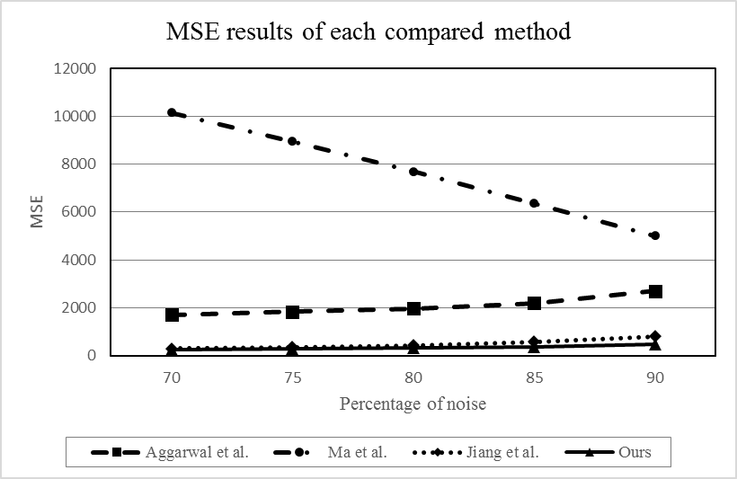
Experimental results(6/6)
MSE metrics over 15 gray scale image sets
Fig. 14. Comparison of MSE results between each compared method for fifteen high density noise images, where the percentage of noise is increased from 70% to 90%
Notes:
MSE

Slide 25
Conclusions(1/1)
We propose a new denoising method based on the optimized sparse approximation using the ant-colony optimization for high-density impulse noise removal.
Our method employs the inverse-distance weighting based prediction model to produce potential noise-fixed pixels for sparse approximation learning.
And uses the ant-colony optimization to seek a better reconstruction result though the no-reference 𝑄 metric for high-density impulse noise removal.
Notes:
我們提出了一個全新的方法來處理高密度的雜訊去除
我們的方法使用了 IDW based prediction model來提供足夠的資訊去做SR的學習
並透過ACO的方式來更進一步取得更好的除雜訊效果

Slide 26
References(1/2)
[1] S.C. Huang, “An Advanced Motion Detection Algorithm with Video Quality Analysis for Video Surveillance Systems," IEEE Trans. Circuits Syst. Video Technol., vol. 21, no.1, Jan. 2011.
[2] T. A. Nodes and N. C. Gallagher, “Median filters: Some modifications and their properties," IEEE Trans. Acoust., Speech, Signal Process., vol. ASSP-30, no. 5, pp. 739–746, Oct. 1982.
[3] K. K. V. Toh and N. A.M. Isa, “Noise adaptive fuzzy switching median filter for salt-and-pepper noise reduction," IEEE Signal Process. Lett., vol. 17, no. 3, pp. 281-284, Mar. 2010.
[4] S. Esakkirajan, T. Veerakumar, Adabala N. Subramanyam, and C. H. PremChand, “Removal of high density salt and pepper noise through modified decision based unsymmetric trimmed median filter," IEEE Signal Process. Lett., vol. 18, no. 5, pp. 287-290, May 2011.
[5] P. Zhang and F. Li, “A new adaptive weighted mean filter for removing salt-and-pepper noise," IEEE Signal Process. Lett., vol. 21, no. 10, pp. 1280-1283, Oct. 2014.
[6] M.-H. Hsieh, F.-C. Cheng, M.-C. Shie, and S.-J. Ruan, “Fast and efficient median filter for removing 1-99\% levels of salt-and-pepper noise in images," Eng. Applicat. Artif. Intell., vol. 26, no. 4, pp. 1333-1338, Apr. 2013.
[7] F. Chen, G. Ma, L. Lin, and Q. Qin, “Impulsive noise removal via sparse representation," J. Electron. Imaging., vol. 22, no. 4, p. 043014, Oct. 2013.
[8] L. Ma, J. Yu, and T. Zeng, “Sparse representation prior and total variation based image deblurring under impulse noise," SIAM J. Imaging Sci., vol. 6, no. 4, pp. 2258–2284, Nov. 2013.
[9] J. Jiang, L. Zhang, and J.Yang, “Mixed noise removal by weighted encoding with sparse nonlocal regularization," IEEE Trans. Image Process., vol. 23, no. 6, pp. 2651-2662, Jun. 2014.
[10] H. K. Aggarwal and A. Majumdar, “Exploiting spatio-spectral correlation for impulse denoising in hyperspectral images," SPIE J. Electron. Imag., vol. 24, no. 1, Feb. 2015, Art. no. 013027.

Slide 27
References(2/2)
[11] I. Aizenberg and C. Butakoff, “Effective Impulse Detector Based on Rank-Order Criteria,” IEEE Trans. Signal Process. Lett., vol. 11, no. 3, Mar. 2004.
[12] Y. Dong and S. Xu, “A New Directional Weighted Median Filter for Removal of Random-Valued Impulse Noise,” IEEE Trans. Signal Process. Lett., vol. 14, no. 3, Mar. 2007.
[13] C.Y. Lien, C.C. Huang, P.Y. Chen and Y.F. Lin, “An Efficient Denoising Architecture for Removal of Impulse Noise in Images,” IEEE Trans. Comput., vol. 62, no.4, Apr. 2013.
[14] G.Y. Lu and D.W. Wong, “An adaptive inverse-distance weighting spatial interpolation technique”, Computer & Geosciences, vol. 34, no. 9, pp. 1044-1055, Sep. 2008.
[15] M. Elad and M. Aharon, “Image denoising via sparse and redundant representations over learned dictionaries,” IEEE Trans. Image Process., vol. 15, no. 12, pp. 37363745, Dec. 2006.
[16] M. Elad, R. Rubinstein, and M. Zibulevsky, “Efficient Implementation of the K-SVD Algorithm using Batch Orthogonal Matching Pursuit," Technical Report–CS, Technion, Apr. 2008.
[17] Dorigo, M., “Optimization, Learning and Natural Algorithms (in Italian)," Ph.D. thesis, Dipartimento di Elettronica, Politecnico di Milano, Italy. 1992.
[18] K. Socha and M. Dorigo., “Ant colony optimization for continuous domains," European Journal of Operational Research, vol. 185, pp. 1155-1173, 2008.
[19] X. Zhu and P. Milainfar., “Automatic Parameter Selection for Denoising Algorithms Using a No-Reference Measure of Image Content,” IEEE Trans. Image Process., vol. 19, no. 12, Dec. 2010.
[20] R.S. Jadon and U. Ditta, “Modified Ant Colony Optimization Algorithm with Uniform Mutation using Self-Adaptive Approach," International Journal of Computer Applications, vol. 74, no. 13, Jul. 2013.
[21] F.C. Cheng and S.C. Huang, “Efficient Histogram Modification Using Bilateral Bezier Curve for the Contrast Enhancement," Journal of Display Technology, vol. 9, no.1, pp. 44-50, Jan. 2013.
[22] S.C Huang, F.C Cheng and Y.S. Chiu, “Efficient Contrast Enhancement Using Adaptive Gamma Correction With Weighting Distribution,'' IEEE Trans. Image Process., vol. 22, no. 3, Mar. 2013.

Slide 28
Thanks !!
Q & A

